Slide 1
William Stallings
Computer Organization and Architecture
8th Edition
Chapter 13
Reduced Instruction Set Computers

Slide 2
Major Advances in Computers(1)
The family concept
  IBM System/360 1964
  DEC PDP-8
  Separates architecture from implementation
Microporgrammed control unit
  Idea by Wilkes 1951
  Produced by IBM S/360 1964
Cache memory
  IBM S/360 model 85 1969

Slide 3
Major Advances in Computers(2)
Solid State RAM
  (See memory notes)
Microprocessors
  Intel 4004 1971
Pipelining
  Introduces parallelism into fetch execute cycle
Multiple processors

Slide 4
The Next Step - RISC
Reduced Instruction Set Computer
Key features
  Large number of general purpose registers
  or use of compiler technology to optimize register use
  Limited and simple instruction set
  Emphasis on optimising the instruction pipeline

Slide 5
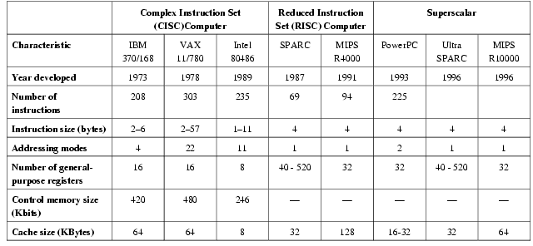
Comparison of processors

Slide 6
Driving force for CISC
Software costs far exceed hardware costs
Increasingly complex high level languages
Semantic gap
Leads to:
  Large instruction sets
  More addressing modes
  Hardware implementations of HLL statements
    e.g. CASE (switch) on VAX

Slide 7
Intention of CISC
Ease compiler writing
Improve execution efficiency
  Complex operations in microcode
Support more complex HLLs

Slide 8
Execution Characteristics
Operations performed
Operands used
Execution sequencing
Studies have been done based on programs written in HLLs
Dynamic studies are measured during the execution of the program

Slide 9
Operations
Assignments
  Movement of data
Conditional statements (IF, LOOP)
  Sequence control
Procedure call-return is very time consuming
Some HLL instruction lead to many machine code operations

Slide 10
Weighted Relative Dynamic Frequency of HLL Operations [PATT82a]
Dynamic Occurrence
Machine-Instruction Weighted
Memory-Reference Weighted
Pascal
C
Pascal
C
Pascal
C
ASSIGN
45%
38%
13%
13%
14%
15%
LOOP
5%
3%
42%
32%
33%
26%
CALL
15%
12%
31%
33%
44%
45%
IF
29%
43%
11%
21%
7%
13%
GOTO
—
3%
—
—
—
—
OTHER
6%
1%
3%
1%
2%
1%

Slide 11
Operands
Mainly local scalar variables
Optimisation should concentrate on accessing local variables
Pascal
C
Average
Integer Constant
16%
23%
20%
Scalar Variable
58%
53%
55%
Array/Structure
26%
24%
25%

Slide 12
Procedure Calls
Very time consuming
Depends on number of parameters passed
Depends on level of nesting
Most programs do not do a lot of calls followed by lots of returns
Most variables are local
(c.f. locality of reference)

Slide 13
Implications
Best support is given by optimising most used and most time consuming features
Large number of registers
  Operand referencing
Careful design of pipelines
  Branch prediction etc.
Simplified (reduced) instruction set

Slide 14
Large Register File
Software solution
  Require compiler to allocate registers
  Allocate based on most used variables in a given time
  Requires sophisticated program analysis
Hardware solution
  Have more registers
  Thus more variables will be in registers

Slide 15
Registers for Local Variables
Store local scalar variables in registers
Reduces memory access
Every procedure (function) call changes locality
Parameters must be passed
Results must be returned
Variables from calling programs must be restored

Slide 16
Register Windows
Only few parameters
Limited range of depth of call
Use multiple small sets of registers
Calls switch to a different set of registers
Returns switch back to a previously used set of registers

Slide 17
Register Windows cont.
Three areas within a register set
  Parameter registers
  Local registers
  Temporary registers
  Temporary registers from one set overlap parameter registers from the next
  This allows parameter passing without moving data

Slide 18
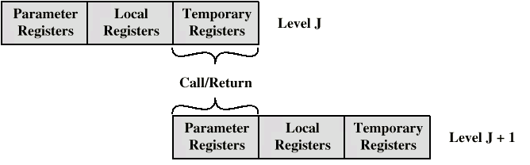
Overlapping Register Windows

Slide 19
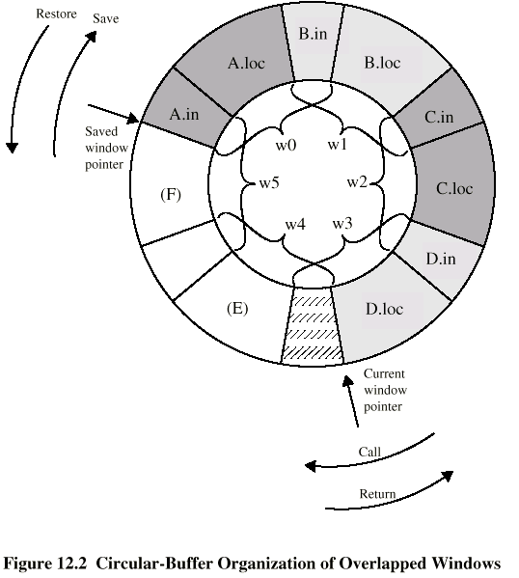
Circular Buffer diagram

Slide 20
Operation of Circular Buffer
When a call is made, a current window pointer is moved to show the currently active register window
If all windows are in use, an interrupt is generated and the oldest window (the one furthest back in the call nesting) is saved to memory
A saved window pointer indicates where the next saved windows should restore to

Slide 21
Global Variables
Allocated by the compiler to memory
  Inefficient for frequently accessed variables
Have a set of registers for global variables

Slide 22
Registers v Cache
Large Register File
Cache
All local scalars
Recently-used local scalars
Individual variables
Blocks of memory
Compiler-assigned global variables
Recently-used global variables
Save/Restore based on procedure nesting depth
Save/Restore based on cache replacement algorithm
Register addressing
Memory addressing

Slide 23
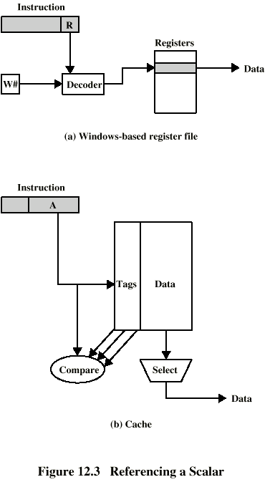
Referencing a Scalar -
Window Based Register File

Slide 24
Referencing a Scalar - Cache

Slide 25
Compiler Based Register Optimization
Assume small number of registers (16-32)
Optimizing use is up to compiler
HLL programs have no explicit references to registers
  usually - think about C - register int
Assign symbolic or virtual register to each candidate variable
Map (unlimited) symbolic registers to real registers
Symbolic registers that do not overlap can share real registers
If you run out of real registers some variables use memory

Slide 26
Graph Coloring
Given a graph of nodes and edges
Assign a color to each node
Adjacent nodes have different colors
Use minimum number of colors
Nodes are symbolic registers
Two registers that are live in the same program fragment are joined by an edge
Try to color the graph with n colors, where n is the number of real registers
Nodes that can not be colored are placed in memory

Slide 27
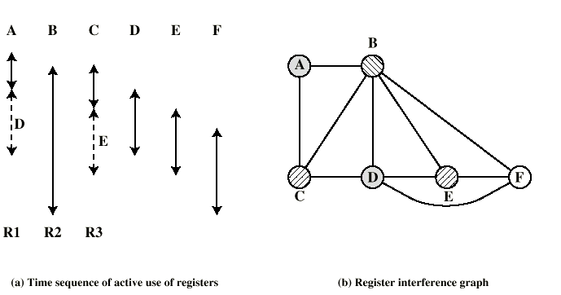
Graph Coloring Approach

Slide 28
Why CISC (1)?
Compiler simplification?
  Disputed…
  Complex machine instructions harder to exploit
  Optimization more difficult
Smaller programs?
  Program takes up less memory but…
  Memory is now cheap
  May not occupy less bits, just look shorter in symbolic form
    More instructions require longer op-codes
    Register references require fewer bits

Slide 29
Why CISC (2)?
Faster programs?
  Bias towards use of simpler instructions
  More complex control unit
  Microprogram control store larger
  thus simple instructions take longer to execute
It is far from clear that CISC is the appropriate solution

Slide 30
RISC Characteristics
One instruction per cycle
Register to register operations
Few, simple addressing modes
Few, simple instruction formats
Hardwired design (no microcode)
Fixed instruction format
More compile time/effort

Slide 31
RISC v CISC
Not clear cut
Many designs borrow from both philosophies
e.g. PowerPC and Pentium II

Slide 32
RISC Pipelining
Most instructions are register to register
Two phases of execution
  I: Instruction fetch
  E: Execute
    ALU operation with register input and output
For load and store
  I: Instruction fetch
  E: Execute
    Calculate memory address
  D: Memory
    Register to memory or memory to register operation

Slide 33
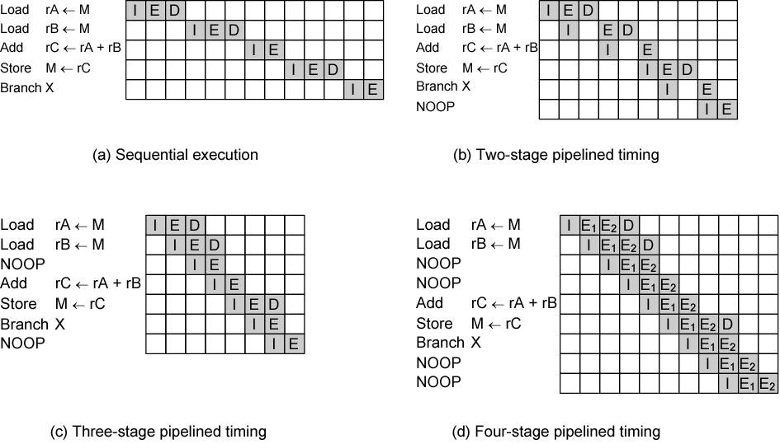
Effects of Pipelining

Slide 34
Optimization of Pipelining
Delayed branch
  Does not take effect until after execution of following instruction
  This following instruction is the delay slot
Delayed Load
  Register to be target is locked by processor
  Continue execution of instruction stream until register required
  Idle until load complete
  Re-arranging instructions can allow useful work whilst loading
Loop Unrolling
  Replicate body of loop a number of times
  Iterate loop fewer times
  Reduces loop overhead
  Increases instruction parallelism
  Improved register, data cache or TLB locality

Slide 35
Loop Unrolling Twice
Example
do i=2, n-1
a[i] = a[i] + a[i-1] * a[i+l]
end do
Becomes
do i=2, n-2, 2
a[i] = a[i] + a[i-1] * a[i+i]
a[i+l] = a[i+l] + a[i] * a[i+2]
end do
if (mod(n-2,2) = i) then
a[n-1] = a[n-1] + a[n-2] * a[n]
end if

Slide 36
Normal and Delayed Branch
Address
Normal Branch
Delayed Branch
Optimized Delayed Branch
100
LOAD X, rA
LOAD X, rA
LOAD X, rA
101
ADD 1, rA
ADD 1, rA
JUMP 105
102
JUMP 105
JUMP 106
ADD 1, rA
103
ADD rA, rB
NOOP
ADD rA, rB
104
SUB rC, rB
ADD rA, rB
SUB rC, rB
105
STORE rA, Z
SUB rC, rB
STORE rA, Z
106
STORE rA, Z

Slide 37
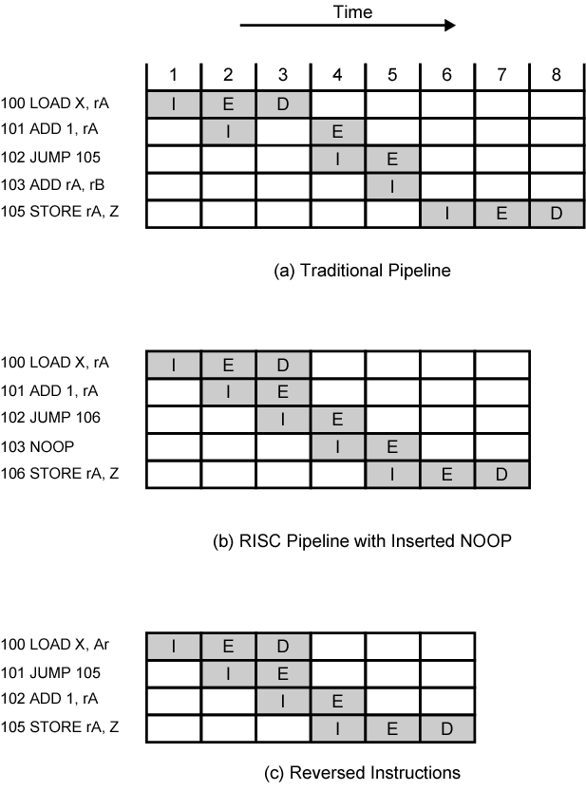
Use of Delayed
Branch

Slide 38
Controversy
Quantitative
  compare program sizes and execution speeds
Qualitative
  examine issues of high level language support and use of VLSI real estate
Problems
  No pair of RISC and CISC that are directly comparable
  No definitive set of test programs
  Difficult to separate hardware effects from complier effects
  Most comparisons done on “toy” rather than production machines
  Most commercial devices are a mixture

Slide 39
Required Reading
Stallings chapter 13
Manufacturer web sites

